Slide 1
Week 002
Demand Forecasting

Slide 2
Week 002: Demand Forecasting
Learning Objectives
LEARNING OBJECTIVES
Identify terms related to demand forecasting
Analyze importance and objectives of demand forecasting
Evaluate factors which affect demand forecasting
Examine the basic concepts, procedures and techniques related to forecasting/demand forecasting

Slide 3
Week 002: Demand Forecasting
Introduction to Forecasting
FORECASTING
prediction the future as accurately as possible, available information which includes historical data and knowledge of any future events that might impact the forecasts should be given.

Slide 4
Week 002: Demand Forecasting
Introduction to Forecasting
TYPES OF FORECAST
Short-term forecasts
Medium-term forecasts
Long-term forecasts

Slide 5
Week 002: Demand Forecasting
Introduction to Forecasting
SHORT-TERM FORECASTS
These are needed for personnel scheduling and scheduling of production and transportation.

Slide 6
Week 002: Demand Forecasting
Introduction to Forecasting
MEDIUM -TERM FORECASTS
Used to determine the future resource requirements. These are done to purchase raw materials, buy machinery and equipment and to hire personnel.

Slide 7
Week 002: Demand Forecasting
Introduction to Forecasting
LONG -TERM FORECASTS
These are utilized in strategic planning wherein market opportunities, environmental factors and internal resources should be taken into account.

Slide 8
Week 002: Demand Forecasting
Introduction to Forecasting
OTHER POPULAR DEFINITIONS OF DEMAND FORECASTING
Demand estimation or forecasting refers to the process of finding values for demand in the future. – Douglas, Evan J.
Demand forecasting is a sales estimate during a specified time in the future based on the proposed marketing plan and a set of a specific uncontrollable and competitive forces.

Slide 9
Week 002: Demand Forecasting
Introduction to Forecasting
IMPORTANCE OF DEMAND FORECASTING
Fulfilling objectives
Preparing the budget
Stabilizing employment and production
Expanding organizations
Taking management decisions
Evaluating performance
Helping government

Slide 10
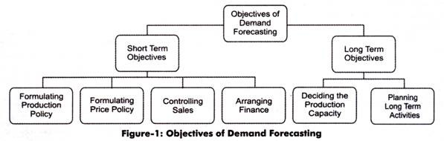
Week 002: Demand Forecasting
Introduction to Forecasting
OBJECTIVES OF FORECASTING
Figure 1 - Short and Long-Term Objectives of Demand Forecasting
Demand Forecasting: Concept, Significance, Objectives and Factors. (2015, August 11). Retrieved June 4, 2018, from http://www.economicsdiscussion.net/demand-forecasting/demand-forecasting-concept-significance-objectives-and-factors/3557

Slide 11
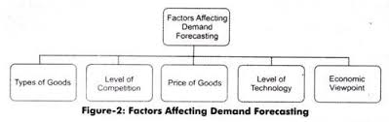
Week 002: Demand Forecasting
Introduction to Forecasting
FACTORS AFFECTING FORECASTING
Figure 2 - Factors Affecting Demand Forecasting
Demand Forecasting: Concept, Significance, Objectives and Factors. (2015, August 11). Retrieved June 4, 2018, from http://www.economicsdiscussion.net/demand-forecasting/demand-forecasting-concept-significance-objectives-and-factors/3557

Slide 12
Week 002: Demand Forecasting
Forecasting Approaches
FORECASTING APPROACHES
Qualitative Approach - include the methods consisting mainly of inputs which are subjective and often defy precise numerical description.
2. Quantitative Approach - is consist of objective or hard data analysis.

Slide 13
Week 002: Demand Forecasting
Cost implication and decision making using forecasting
COST IMPLICATION AND DECISION MAKING USING FORECASTING
the use of business forecasts is the key to successful business operations, planning and strategy.
Useful forecast about future uncertain events are essential since business planning and strategy entail decision and actions at the present time which will have consequences in the future. Thus, a significant source of information for management is the business forecast.

Slide 14
Week 002: Demand Forecasting
Cost implication and decision making using forecasting
COST IMPLICATION AND DECISION MAKING USING FORECASTING
Items to be forecasted include the prices of raw materials, the prices of supplies and required products, prices of competitor and the general market prices.
In making decisions, management carries with it some consequence real costs, costs associated with the wrong application of valuable resources over and over again.

Slide 15
Week 002: Demand Forecasting
Cost implication and decision making using forecasting
COST IMPLICATION AND DECISION MAKING USING FORECASTING
Forecasts that compare favorably with actual outcomes and have reasonable chance of occurring are involved in good time estimates.
Production operations manager, deciding on the matters of forecasting and applying it in planning and using strategies to increase profit should be done effectively.

Slide 16
Week 002: Demand Forecasting
Cost implication and decision making using forecasting
COST IMPLICATION AND DECISION MAKING USING FORECASTING
Managers should act now to plan and establish through forecasts considering the consistent target completion dates with the use of resources – men, machines and materials and through the use of technologies at hand.
Managers must act at the latter date to control and monitor the project phase evolution with a comparison on the milestones to targeted dates of completion.

Slide 17
Week 002: Demand Forecasting
Forecasting Processes
STEPS TO FOLLOW IN FORECASTING TASKS
Define the problem.
Gather information.
Conduct preliminary analysis
Choose and fit models
Use and evaluate a forecasting model

Slide 18
Week 002: Demand Forecasting
Forecasting Processes
1. Define the problem.
Understanding of the way the forecasts will be used, who requires the forecasts, and how the function of forecasting fits within the organization requiring the forecasts is required in defining the problem carefully.

Slide 19
Week 002: Demand Forecasting
Forecasting Processes
Gather information.
In gathering information, at least two kinds of information is required:
Statistical data
Accumulated expertise of the people who collect the said data and use the forecasts.
In fitting a good statistical model, difficulty may be encountered in obtaining enough historical data. Due to the changes in the system being forecast, occasionally very old data will be less useful.

Slide 20
Week 002: Demand Forecasting
Forecasting Processes
Conduct preliminary analysis
In conducting preliminary analysis, graphing the data should be the starting point. Questions include
Are there consistent patterns?
Is there a relevant trend?
Is seasonality relevant?
Is there evidence of the presence of business cycles?
Are there any outliers in the data that should be explained by experts?
How strong are the relationships among the variables available for analysis?

Slide 21
Week 002: Demand Forecasting
Forecasting Processes
4. Choose and fit models
The availability of historical data, the strength of forecasts variable an explanatory variable relationship and the way the forecast are to be used should be considered in using the best model.
The availability of historical data, the strength of forecasts variable an explanatory variable relationship and the way the forecast are to be used should be considered in using the best model.

Slide 22
Week 002: Demand Forecasting
Forecasting Processes
5. Use and evaluate forecasting model
The model is used to make forecast when a model has been selected and its parameters are already estimated.
After the data for forecast period have become available , the performance of the model can be properly evaluated.
To help in assessing the forecast accuracy, a number of methods have been developed. In using and acting on the forecast, there are also organizational issues.

Slide 23
Week 002: Demand Forecasting
Methods of Forecasting
METHODS OF FORECASTING
Qualitative Methods
Quantitative Methods

Slide 24
Week 002: Demand Forecasting
Methods of Forecasting
QUALITATIVE METHODS
If the data are not available and when the available data are not important to forecast, qualitative methods of forecasting methods should be used.
In obtaining good forecasts without using historical data, well-developed structured approaches are used.

Slide 25
Week 002: Demand Forecasting
Methods of Forecasting
QUANTITATIVE METHODS
These are applied when the following conditions are satisfied:
Numerical data and information about the past is available
Assumption that some aspects of patterns in the past will continue into the future.

Slide 26
Week 002: Demand Forecasting
Methods of Forecasting
QUANTITATIVE METHODS
Cross-sectional forecasting
Time series forecasting

Slide 27
Week 002: Demand Forecasting
Methods of Forecasting
CROSS-SECTIONAL FORECASTING
Using the information on the cases that the business firms have observed, the said firm wants to predict the value of something that has not observed.
With cross-sectional data, we are wanting to predict the value of something we have not observed, using the information on the cases that we have observed.

Slide 28
Week 002: Demand Forecasting
Methods of Forecasting
TIME SERIES FORECASTING
Data on times series are useful when an individual is forecasting something that is changing over time like prices, stock, sales figures, profits and the like.
Time series is Anything that is observed sequentially over time.
The aim of forecasting time series data is to estimate how the observation sequence will continue in the future.

Slide 29
Week 002: Demand Forecasting
Methods of Forecasting
EXAMPLES OF TIME SERIES DATA
Monthly rainfall
Annual google profits
Quarterly sales results for Lazada
The aim of forecasting time series data is to estimate how the observation sequence will continue in the future.

Slide 30
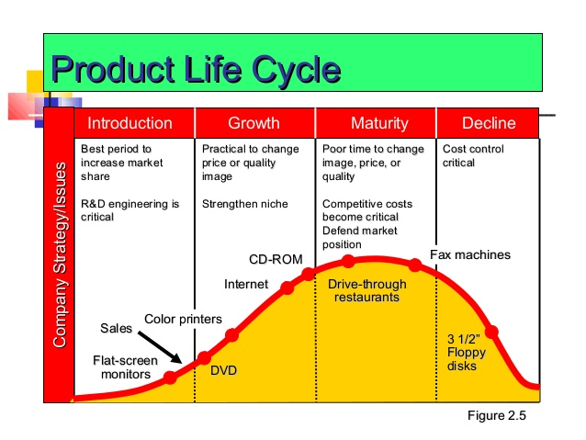
Week 002: Demand Forecasting
Forecasting and the Product Life Cycle
PRODUCT LIFE CYCLE
Figure 3 - Product Life Cycle
Drevale, R. (2015, May 14). Ch 10 forecast. Retrieved June 5, 2018, from https://www.slideshare.net/RioneDrevale/ch-10-forecast

Slide 31
Week 002: Demand Forecasting
Forecasting and the Product Life Cycle
INTRODUCTION
Product designing and development are critical.
Frequently product and process design changes.
There is a short production but has a high production costs at this phase.
Attention to quality should be considered during this stage.

Slide 32
Week 002: Demand Forecasting
Forecasting and the Product Life Cycle
GROWTH
Forecasting is critical and product and process reliability should be considered.
Competitive product options and improvements are present.
There is an increase in the capacity of the firm to supply the product.
Shifting towards product focus is in this stage and enhancement of distribution is aimed to achieve in this phase.

Slide 33
Week 002: Demand Forecasting
Forecasting and the Product Life Cycle
MATURITY
The product has already stabilized standard for the production such product.
Changes in the product is on the minor level.
Cost cutting is achieved on this stage because long production runs and there is a stable improvement in the product offered.

Slide 34
Week 002: Demand Forecasting
Forecasting and the Product Life Cycle
DECLINE
There is a decline in sales, declining profits and lower quality.

Slide 35
Week 002: Demand Forecasting
Forecasting and the Product Life Cycle
FORECASTING AND
THE PRODUCT LIFE CYLE
Many business organizations seek either to innovate and bring new products as well as services to market. Still, top priorities for executives are growth and product innovation.
Creating sales forecasts is one of the largest challenges in managing new product introductions.

Slide 36
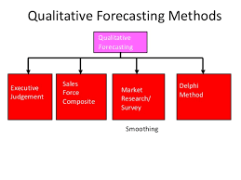
Week 002: Demand Forecasting
Qualitative and quantitative methods of forecasting
QUALITATIVE METHODS OF FORECASTING
Figure 4 - Qualitative Forecasting Methods
Rai University. (2015, March 18). Mba ii pmom_unit-1.3 forecasting a. Retrieved June 4, 2018, from https://www.slideshare.net/raiuniversity/mba-ii-pmomunit13-forecasting-a

Slide 37
Week 002: Demand Forecasting
Qualitative and quantitative methods of forecasting
STEPS TO FOLLOW IN DELPHI METHOD
All group statements are collected and summarized by the coordinator.
Summary is provided by the coordinator and another set of questions are given to each group member including the feedback as to the input of other experts.
The same steps will be repeated until the consensus is reached

Slide 38
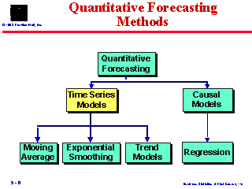
Week 002: Demand Forecasting
Qualitative and quantitative methods of forecasting
QUANTITATIVE FORECASTING METHODS
Figure 5 - Quantitative Forecasting Methods
Quantitative Forecasting Methods. (n.d.). Retrieved June 4, 2018, from http://academic.brooklyn.cuny.edu/economic/klein/30_2/Berenson/CHAP5/sld006.htm

Slide 39
Week 002: Demand Forecasting
Forecasting Accuracy
DETERMINANTS OF FORECASTING ACCURACY
Industry
Forecast horizon
Firm size
Analyst following
Earning type
Earnings management
Financial crisis

Slide 40
Week 002: Demand Forecasting
Forecasting Accuracy
POTENTIAL CAUSES OF FORECAST INACCURACY IN BUSINESS AND INDUSTRY
First, stability of operations among industries are varied. For instance, utilities, are likely to be subject to fewer exogenous than are firms operating with the mining sector, whose operations are subject to fluctuations in commodity prices.
Forecast accuracy is likely to be affected by the innate skill of the analyst.

Slide 41
Week 002: Demand Forecasting
Forecasting Accuracy
POTENTIAL CAUSES OF FORECAST INACCURACY IN BUSINESS AND INDUSTRY
Certain industries may have greater aggregate analyst coverage, which can lead to better marginal information gathering and more accurate consensus estimates.
Accounting factors can be another link in the relationship between accuracy and industry.

Slide 42
REVIEW OF THE LESSON

